Slide 1
Chapter 22 – Attention Model, Transformers, GPT

Slide 2
In This Chapter
Attention model
Trigger word detection
Transformers
LLM – Large Language Model
Generative AI
GPT – Generative pre-trained transformers
ChatGPT

Slide 3
Attention Model

Slide 4
What is Attention?
Attention is the concentration of awareness on some phenomenon to the exclusion of other stimuli.
It is a process of selectively concentrating on a discrete aspect of information, whether considered subjective or objective.

Slide 5
The Problem of Long Sentences (1/2)
Long and convoluted sentences affect comprehension and readability.
Without careful crafting, they can be really hard to understand.
On the other hand, too short sentences make for choppy writing without flow and cannot hold complex thoughts.
Blue Score
A relatively long sentence:
The sun was slowly rising above the mountains spreading its light to the all in the valley and waking up sleeping creatures by its gentle touch.
10 20 30 40 50
Sentence length

Slide 6
The Problem of Long Sentences (2/2)
Y^{<1>}
Y^{<2>}
Y^{<3>}
Y^{<Ty>}
A^{<0>}
A
A
A
…
A^{<Tx>}
A
A
A
…
A
X^{<1>}
X^{<2>}
X^{<3>}
X^{<Tx>}
Blue Score
With long sentences, the network may start losing focus (attention) to keep up with the context and meaning.
10 20 30 40 50
Sentence length

Slide 7
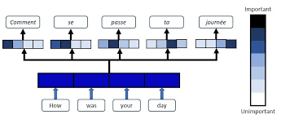
The Idea of the Attention Model (1/3)
Attention models, also called attention mechanisms, are deep learning techniques used to provide an additional focus on a specific component.
In deep learning, attention relates to focus on something in particular and note its specific importance.
Attention was presented by Dzmitry Bahdanau, et al. in their 2014 paper “Neural Machine Translation by Jointly Learning to Align and Translate.”

Slide 8
The Idea of the Attention Model (2/3)
The basic idea of Attention is that at every time step that the decoder predicts output words, it references the entire input sentence from the encoder.
However, instead of referring to all the input sentences at the same rate, you will focus more on the parts of the input words that are related to the words you need to predict at that point.
The idea is to keep the decoder as it is, and we just replace sequential RNN/LSTM with bidirectional RNN/LSTM in the encoder.
Encoder-Decoder architecture with an attention layer

Slide 9
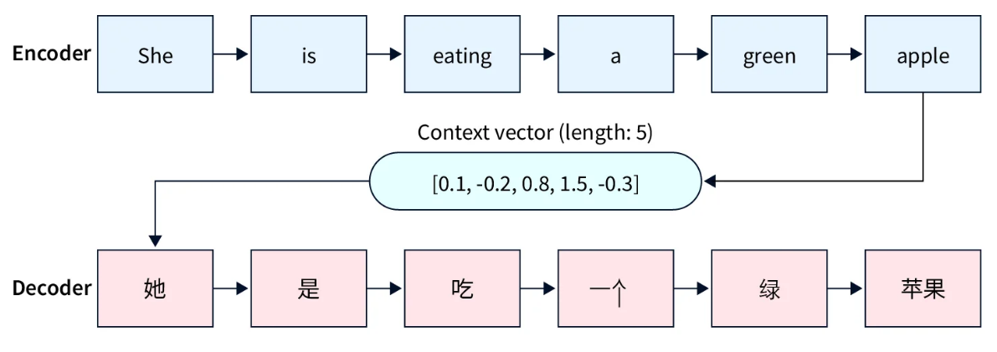
The Idea of the Attention Model (3/3)
In other words, each state from the encoder, each RNN cell, is utilized.
The advantages of Attention can be summarized in two ways here:
It is not a fixed size context vector. The problem that comes from one fixed-size context vector is to refresh the context vector for each state.
Of all the states in Encoder, we can design a mechanism that can only focus on the words we need to focus on.

Slide 10
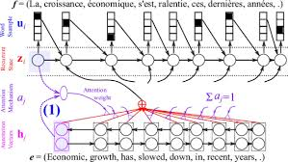
Attention Models Intuition (1/2)
Attention models involve focusing on the most important components while perceiving some of the additional information.
This is similar to the visual attention mechanism that the human brain uses.
For example, the human brain may initially focus on a particular aspect image with a higher resolution focus and view the surrounding areas with a lower resolution.
However, as the brain begins to understand the image, it adjusts the focal point to understand all aspects thoroughly.

Slide 11
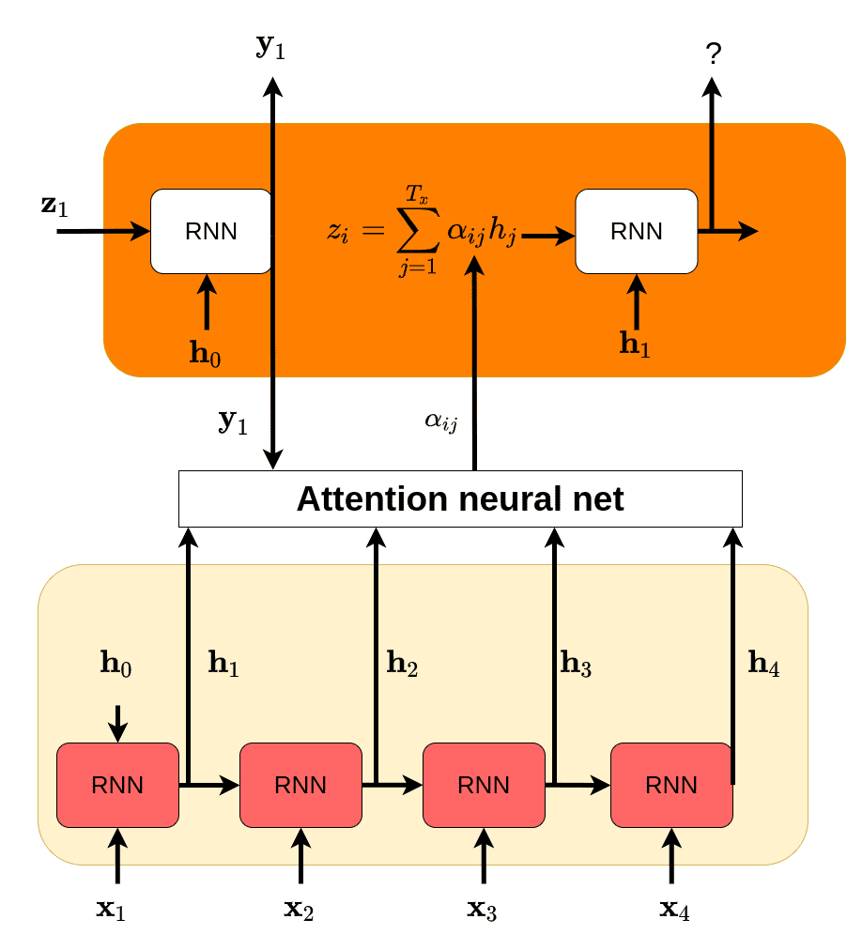
Attention Models Intuition (2/2)
Attention models evaluate inputs to identify the most critical components and assign each of them with a weight.
For example, if using an attention model to translate a sentence from one language to another, the model would select the most important words and assign them a higher weight.
Similarly, it assigns the less significant words a lower value.
This helps achieve a more accurate output prediction.

Slide 12
The Attention Model Mechanism
Each word generated in the decoder Ŷ^{<t>}
is influenced c^{<t>}
by ALL (or most related) words in the decoder X^{<t’>} via h^{<t’>} with different weights α^{<t,t’>} (alpha) which are referred to as „attention“.
English: It is a very good book
Ŷ^{<1>}
Ŷ^{<2>}
Ŷ^{<3>}
Ŷ^{<4>}
Ŷ^{<5>}
Ŷ^{<6>}
S^{<0>}
S^{<1>}
S^{<2>}
S^{<3>}
S^{<4>}
S^{<5>}
S^{<6>}
Dencoder
c^{<1>} c^{<2>} c^{<3>} c^{<4>} c^{<5>} c^{<6>}
h^{<1>} h^{<2>} h^{<3>} h^{<4>} h^{<5>} h^{<6>}
A^{<0>}
A^{<1>}
A^{<2>}
A^{<3>}
A^{<4>}
A^{<5>}
A^{<6>}
B^{<1>}
B^{<2>}
B^{<3>}
B^{<4>}
B^{<5>}
B^{<6>}
B^{<7>}
Encoder
X^{<1>}
X^{<2>}
X^{<3>}
X^{<4>}
X^{<5>}
X^{<6>}
German: Es ist ein sehr gutes Buch

Slide 13
The Attention Model Mechanism
Each word generated in the decoder Ŷ^{<t>}
is influenced c^{<t>}
by ALL (or most related) words in the decoder X^{<t’>} via h^{<t’>} with different weights α^{<t,t’>} (alpha) which are referred to as „attention“.
English: It is a very good book
Ŷ^{<1>}
Ŷ^{<2>}
Ŷ^{<3>}
Ŷ^{<4>}
Ŷ^{<5>}
Ŷ^{<6>}
S^{<0>}
S^{<1>}
S^{<2>}
S^{<3>}
S^{<4>}
S^{<5>}
S^{<6>}
Decoder
c^{<1>} c^{<2>} c^{<3>} c^{<4>} c^{<5>} c^{<6>}
Most important
impacts
h^{<1>} h^{<2>} h^{<3>} h^{<4>} h^{<5>} h^{<6>}
A^{<0>}
A^{<1>}
A^{<2>}
A^{<3>}
A^{<4>}
A^{<5>}
A^{<6>}
B^{<1>}
B^{<2>}
B^{<3>}
B^{<4>}
B^{<5>}
B^{<6>}
B^{<7>}
Encoder
X^{<1>}
X^{<2>}
X^{<3>}
X^{<4>}
X^{<5>}
X^{<6>}
German: Es ist ein sehr gutes Buch

Slide 14
Computing Attention α^{<t,t’>}
α^{<t,t’>} = amount of attention Y^{<t>} should pay to α^{<t>}.
Ŷ^{<1-1>}
Ŷ^{<t>}
Ŷ^{<t+1>}
S^{<1>}
S^{<2>}
S^{<3>}
c^{<t>}
h^{<1>} h^{<2>} h^{<3>} h^{<4>} h^{<5>}
…
A^{<0>}
A^{<1>}
A^{<2>}
A^{<3>}
A^{<4>}
A^{<5>}
B^{<1>}
B^{<2>}
B^{<3>}
B^{<4>}
B^{<5>}
B^{<7>}
X^{<1>}
X^{<2>}
X^{<3>}
X^{<4>}
X^{<5>}

Slide 15
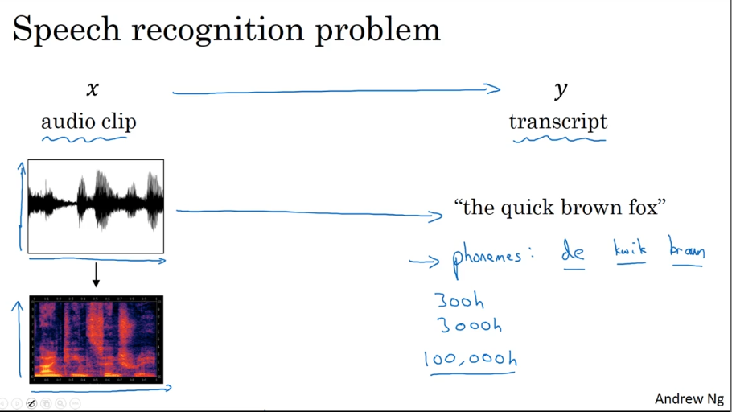
Speech Recognition
X Ŷ
audio clip transcript
“the quick brown fox …”
Phonems: de kwik braun foks
It takes thousands hours (~100,000 hours) to train the system to understand phonemes.

Slide 16
Attention Model for Speech Recognition
Ŷ^{<1-1>}
Ŷ^{<t>}
Ŷ^{<t+1>}
…
S^{<t-1>}
S^{<t>}
S^{<t+1>}
c^{<t>}
O O O O
A^{<1>}
A^{<2>}
…
A^{<Tx>}
A^{<0>}
A^{<Tx-1>}
B^{<1>}
B^{<2>}
B^{<Tx-1>}
B^{<Tx>}
…
X^{<1>}
X^{<2>}
X^{<Tx-1>}
X^{<Tx>}

Slide 17
Attention Model for Speech Recognition
Ŷ^{<1-1>}
Ŷ^{<t>}
Ŷ^{<t+1>}
…
S^{<t-1>}
S^{<t>}
S^{<t+1>}
c^{<t>}
O O O O
A^{<1>}
A^{<2>}
…
A^{<Tx>}
A^{<0>}
A^{<Tx-1>}
B^{<1>}
B^{<2>}
B^{<Tx-1>}
B^{<Tx>}
…
X^{<1>}
X^{<2>}
X^{<Tx-1>}
X^{<Tx>}

Slide 18
Trigger Word Detection

Slide 19
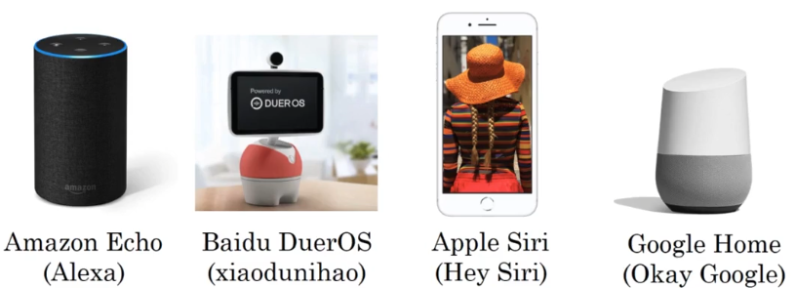
Trigger Word Detection

Slide 20
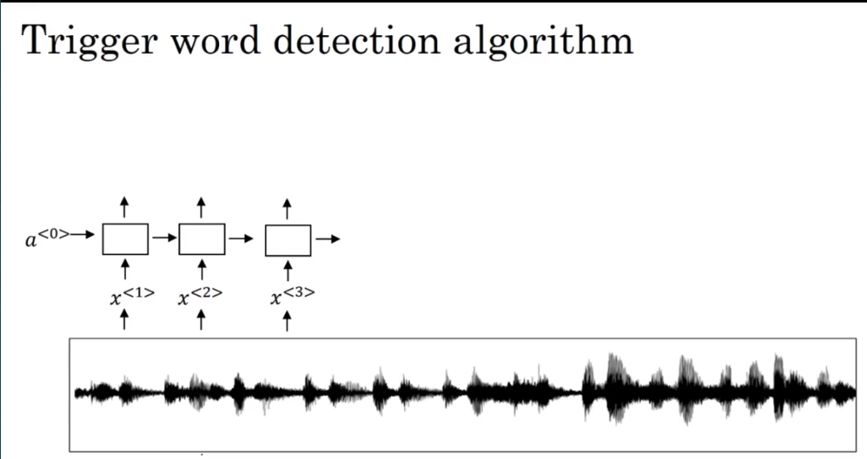
Trigger Word Detection Algorithm
0 0 0 1 1 1 0 1 1 0
A^{<1>}
A^{<2>}
A^{<3>}
A^{<4>}
A^{<5>}
A^{<6>}
…
A<..>
A<..>
A<..>
A<..>
A^{<0>}
X^{<1>}
X^{<1>}
X^{<1>}
X^{<4>}
X^{<5>}
X^{<6>}
X<..>
X<..>
X<.>
X<..>

Slide 21
Transformers

Slide 22
RNN -> GRU -> LSTM
Complexity
All these models are sequential that implies that to compute any input is transformed into output sequentially, i.e. to compute any word or token) including the final token, a preceding word (token) must be computed.
RNN
GRU
LSTM
Ŷ^{<t>}
Ŷ^{<1>}
Ŷ^{<2>}
Ŷ^{<Ty>}
C^{<t-1>}
C^{<t>}
C^{<t-1>}
C^{<t>}
X
+
…
Č^{<t>}
tanh
Γ_{f}
Γ_{U}
Γ_{r}
X
X
Γ₀
Ŷ^{<t-1>}
σ
σ
tanh
σ
Ŷ^{<t>}
A^{<t-1>}
A^{<t>}
X
X^{<t>}
X^{<t>}

Slide 23
Transformer Network Idea
Transformer = Attention + CNN
Self attention
Multihead attention
RNN –> attention -> sequential
CNN -> parallel
Ŷ^{<1>}
Ŷ^{<2>}
Ŷ^{<Ty>}
…
parallel
X
sequential

Slide 24
RNN Attention
RNN
Attention imact alpha, α^{<t,t‘>}, is calculated for each word X^{<t>} in its connection to other words X^{<t‘>}.
A^{<t>} is attention-based vecor representation of a word.
A^{<1>} A^{<2>} A^{<3>} A^{<4>} A^{<5>}
X^{<1>} X^{<2>} X^{<3>} X^{<4>} X^{<5>}
German: Es ist ein gutes Buch

Slide 25
Transformers: Self Attention
Transformer = Attention + CNN
Self attention
Multihead attention
Self-attention operates by transforming the input sequence into three vectors: query, key, and value.
These vectors are obtained through linear transformations of the input.
The attention mechanism calculates a weighted sum of the values based on the similarity between the query and key vectors.

Slide 26
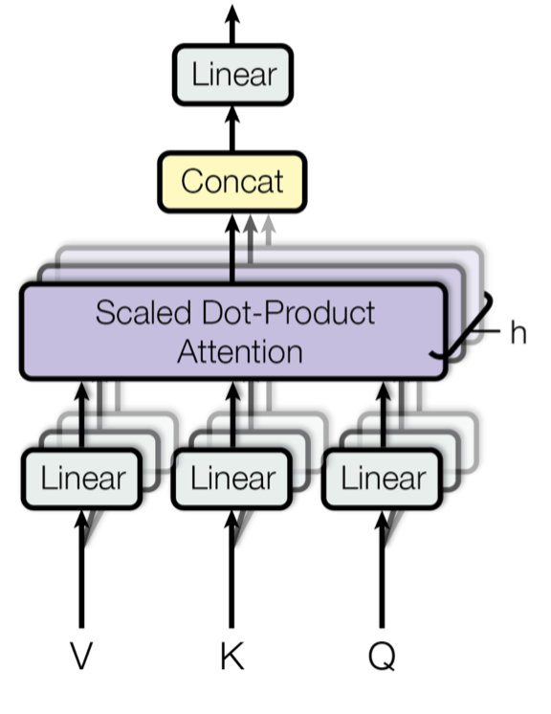
Transformers: Multihead Attention
Transformer = Attention + CNN
Self attention
Multihead attention
Multi-head Attention is a module for attention mechanisms which runs through an attention mechanism several times in parallel.
The independent attention outputs are then concatenated and linearly transformed into the expected dimension.
Intuitively, multiple attention heads allows for attending to parts of the sequence differently (e.g. longer-term dependencies versus shorter-term dependencies).

Slide 27
Self-Attention Concept: Transformers Attention
The self-attention model focuses on different positions from the same input sequence.
It may be possible to use the global attention and local attention model frameworks to create this model.
However, the self-attention model includes the same input sequence in place of the target output sequence.
Transformer
q^{<1>}
k^{<1>}
v^{<1>}
q^{<2>}
k^{<2>}
v^{<2>}
q^{<3>}
k^{<3>}
v^{<3>}
q^{<4>}
k^{<4>}
v^{<4>}
q^{<5>}
k^{<5>}
v^{<5>}
The self-attention model focuses on different positions from the same input sequence.
X^{<1>} X^{<2>} X^{<3>} X^{<4>} X^{<5>}
German: Ich werde bald Amerika besuchen

Slide 28
Self-Attention
Query (Q) | Key (K) | Value (V)
q^{<1>} | k^{<1>} | v^{<1>}
q^{<2>} | k^{<2>} | v^{<2>}
q^{<3>} | k^{<3>} | v^{<3>}
q^{<4>} | k^{<4>} | v^{<4>}
q^{<5>} | k^{<5>} | v^{<5>}
A^{<3>}
q^{<4>} = W^{Q} X^{<4>}
k^{<4>} = W^{K} X^{<4>}
v^{<4>} = W^{V} X^{<4>}
Query q^{<3>} with all possible keys k^{<t>}.
q^{<3>} k^{<1>}
q^{<3>} k^{<2>}
q^{<3>} k^{<3>}
q^{<3>} k^{<4>}
q^{<1>} k^{<1>}
q^{<1>}
k^{<1>}
v^{<1>}
q^{<2>}
k^{<2>}
v^{<2>}
q^{<3>}
k^{<3>}
v^{<3>}
q^{<4>}
k^{<4>}
v^{<4>}
q^{<5>}
k^{<5>}
v^{<5>}
Query q^{<4>} : America as a destination country (USA) rather than a continent.
X^{<1>} X^{<2>} X^{<3>} X^{<4>} X^{<5>}
German: Ich werde bald Amerika besuchen

Slide 29
Self-Attention
Query (Q) | Key (K) | Value (V)
q^{<1>} | k^{<1>} | v^{<1>}
q^{<2>} | k^{<2>} | v^{<2>}
q^{<3>} | k^{<3>} | v^{<3>}
q^{<4>} | k^{<4>} | v^{<4>}
q^{<5>} | k^{<5>} | v^{<5>}
A^{<1>} A^{<2>} A^{<3>} A^{<4>} A^{<5>}
v^{<1>} v^{<2>} v^{<3>} v^{<4>} v^{<5>}
X
X
X
X
X
q^{<3>} = W^{Q} X^{<3>}
k^{<3>} = W^{K} X^{<3>}
v^{<3>} = W^{V} X^{<3>}
q^{<3>} k^{<1>}
q^{<3>} k^{<2>}
q^{<3>} k^{<3>}
q^{<3>} k^{<4>}
q^{<1>} k^{<1>}
Query q^{<3>} with all possible keys k^{<t>}.
q^{<1>}
k^{<1>}
v^{<1>}
q^{<2>}
k^{<2>}
v^{<2>}
q^{<3>}
k^{<3>}
v^{<3>}
q^{<4>}
k^{<4>}
v^{<4>}
q^{<5>}
k^{<5>}
v^{<5>}
Query q^{<3>} : America as a destination country (USA) rather than a continent.
X^{<1>} X^{<2>} X^{<3>} X^{<4>} X^{<5>}
German: Ich werde bald Amerika besuchen

Slide 30
Self-Attention
Query (Q) | Key (K) | Value (V)
q^{<1>} | k^{<1>} | v^{<1>}
q^{<2>} | k^{<2>} | v^{<2>}
q^{<3>} | k^{<3>} | v^{<3>}
q^{<4>} | k^{<4>} | v^{<4>}
q^{<5>} | k^{<5>} | v^{<5>}
A^{<1>} A^{<2>} A^{<3>} A^{<4>} A^{<5>}
+
v^{<1>} v^{<2>} v^{<3>} v^{<4>} v^{<1>}
X
X
X
X
X
q^{<3>} = W^{Q} X^{<3>}
k^{<3>} = W^{K} X^{<3>}
v^{<3>} = W^{V} X^{<3>}
Query q^{<3>} with all possible keys k^{<t>}.
q^{<3>} k^{<1>}
q^{<3>} k^{<2>}
q^{<3>} k^{<3>}
q^{<3>} k^{<4>}
q^{<1>} k^{<1>}
q^{<1>}
k^{<1>}
v^{<1>}
q^{<2>}
k^{<2>}
v^{<2>}
q^{<3>}
k^{<3>}
v^{<3>}
q^{<4>}
k^{<4>}
v^{<4>}
q^{<5>}
k^{<5>}
v^{<5>}
Query q^{<3>} : America as a destination country (USA) rather than a continent.
X^{<1>} X^{<2>} X^{<3>} X^{<4>} X^{<5>}
German: Ich werde bald Amerika besuchen

Slide 31
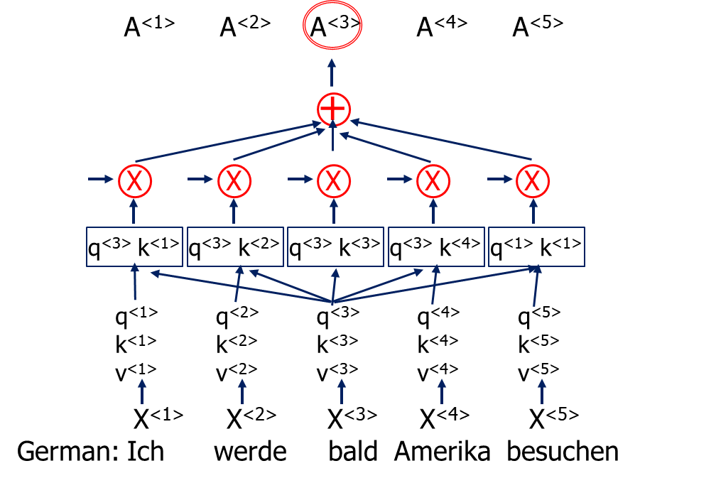
Self-Attention
Query (Q) | Key (K) | Value (V)
q^{<1>} | k^{<1>} | v^{<1>}
q^{<2>} | k^{<2>} | v^{<2>}
q^{<3>} | k^{<3>} | v^{<3>}
q^{<4>} | k^{<4>} | v^{<4>}
q^{<5>} | k^{<5>} | v^{<5>}
q^{<3>} = W^{Q} X^{<3>}
k^{<3>} = W^{K} X^{<3>}
v^{<3>} = W^{V} X^{<3>}
Query q^{<3>} : America as a destination country (USA) rather than a continent.

Slide 32
Self-Attention
Query (Q) | Key (K) | Value (V)
q^{<1>} | k^{<1>} | v^{<1>}
q^{<2>} | k^{<2>} | v^{<2>}
q^{<3>} | k^{<3>} | v^{<3>}
q^{<4>} | k^{<4>} | v^{<4>}
q^{<5>} | k^{<5>} | v^{<5>}
A^{<1>} A^{<2>} A^{<3>} A^{<4>} A^{<5>}
+
v^{<1>} v^{<2>} v^{<3>} v^{<4>} v^{<1>}
X
X
X
X
X
q^{<3>} = W^{Q} X^{<3>}
k^{<3>} = W^{K} X^{<3>}
v^{<3>} = W^{V} X^{<3>}
Thus, attention can be calculated for each word in the sentence.
q^{<3>} k^{<1>}
q^{<3>} k^{<2>}
q^{<3>} k^{<3>}
q^{<3>} k^{<4>}
q^{<1>} k^{<1>}
q^{<1>}
k^{<1>}
v^{<1>}
q^{<2>}
k^{<2>}
v^{<2>}
q^{<3>}
k^{<3>}
v^{<3>}
q^{<4>}
k^{<4>}
v^{<4>}
q^{<5>}
k^{<5>}
v^{<5>}
X^{<1>} X^{<2>} X^{<3>} X^{<4>} X^{<5>}
German: Ich werde bald Amerika besuchen

Slide 33
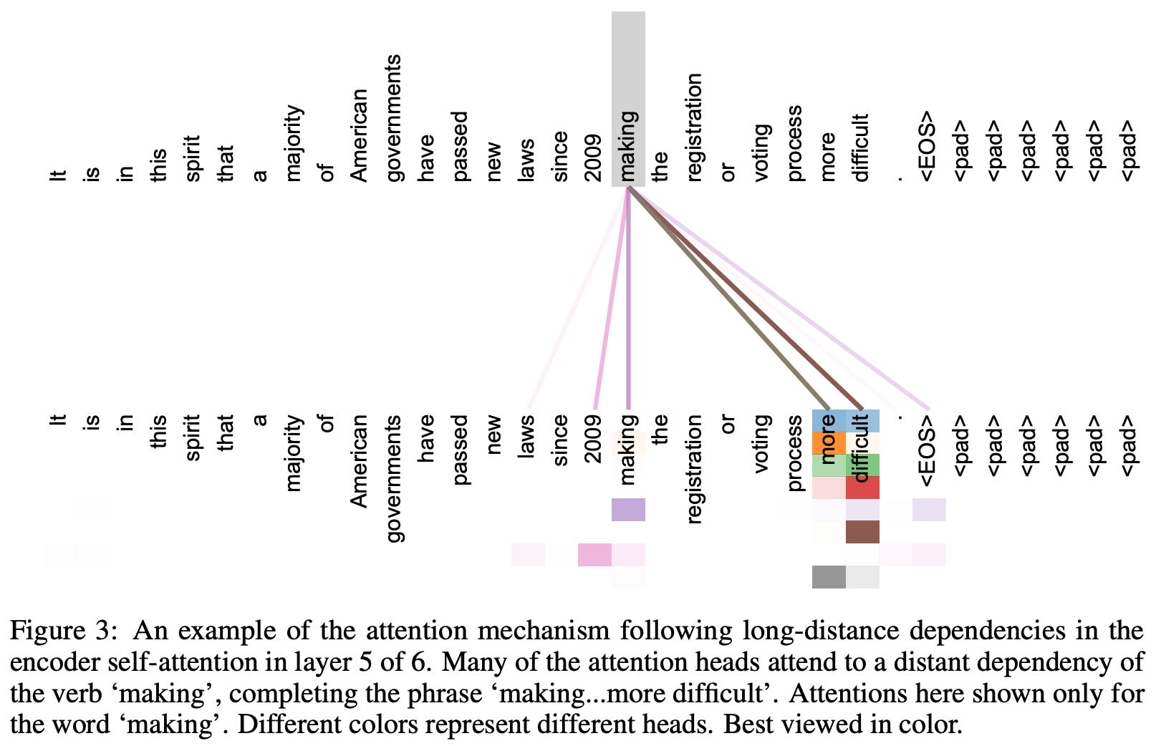
Another Example of Self-Attention
The self-attention model focuses on different positions from the same input sequence.
https://cameronrwolfe.substack.com/p/decoder-only-transformers-the-workhorse

Slide 34
Multi-Head Attention Concept (1/2)
In practice, given the same set of queries, keys, and values we may want our model to combine knowledge from different behaviors of the same attention mechanism, such as capturing dependencies of various ranges (e.g., shorter-range vs. longer-range) within a sequence.
Thus, it may be beneficial to allow our attention mechanism to jointly use different representation subspaces of queries, keys, and values.
To this end, instead of performing a single attention pooling, queries, keys, and values can be transformed with independently learned linear projections.
Then these projected queries, keys, and values are fed into attention pooling in parallel.

Slide 35
Multi-Head Attention Concept (1/2)
In the end, attention-pooling outputs are concatenated and transformed with another learned linear projection to produce the final output.
This design is called multi-head attention, where each of the attention pooling outputs is a head (Vaswani et al., 2017).
Using fully connected layers to perform learnable linear transformations.
Linear
Concat
Scaled Dot-Product Attention
Scaled Dot-Product Attention
Scaled Dot-Product Attention
Linear
Linear
Linear
Linear
Linear
Linear
Linear
Linear
Linear
V K Q

Slide 36
Multi-Head Attention (1/2)
Multi-head Attention is a module for attention mechanisms which runs through the attention mechanism several times in parallel.
The independent attention outputs are then concatenated and linearly transformed into the expected dimension.
Intuitively, multiple attention heads allows for attending to parts of the sequence differently (e.g. longer-term dependencies versus shorter-term dependencies).

Slide 37
Multi-Head Attention (2/2)
Note that scaled dot-product attention is most commonly used in this module, although in principle it can be swapped out for other types of attention mechanism.
Linear
Concat
Scaled Dot-Product Attention
Scaled Dot-Product Attention
Scaled Dot-Product Attention
Linear
Linear
Linear
Linear
Linear
Linear
Linear
Linear
Linear
V K Q

Slide 38
Multi-Head Attention
Multi-Head(Q, K, V)
= concat(head₁, head₂,..., head_{h})W₀
head_{i} = Attention(W_{i}^{Q}Q, W_{i}^{K}K, W_{i}^{V}V)
Attention(W_{i}^{Q}Q, W_{i}^{K}K, W_{i}^{V}V)
Attention(W_{i}^{Q}Q, W_{i}^{K}K, W_{i}^{V}V)
Attention(W_{i}^{Q}Q, W_{i}^{K}K, W_{i}^{V}V)
W_{i}^{Q}q^{<1>},W_{i}^{K}k^{<1>},W_{i}^{V}v^{<1>}
W_{i}^{Q}q^{<2>},W_{i}^{K}k^{<2>},W_{i}^{V}v^{<2>}
W_{i}^{Q}q^{<3>},W_{i}^{K}k^{<3>},W_{i}^{V}v^{<3>}
W_{i}^{Q}q^{<4>},W_{i}^{K}k^{<4>},W_{i}^{V}v^{<4>}
W_{i}^{Q}q^{<5>},W_{i}^{K}k^{<5>},W_{i}^{V}v^{<5>}
q^{<1>},k^{<1>},v^{<1>}
q^{<2},k^{<2>},v^{<2>}
q^{<3>},k^{<3>},v^{<3>}
q^{<4>},k^{<4>},v^{<4>}
q^{<5>},k^{<5>},v^{<5>}
X^{<1>} X^{<2>} X^{<3>} X^{<4>} X^{<5>}
Ich werde bald Amerika besuchen

Slide 39
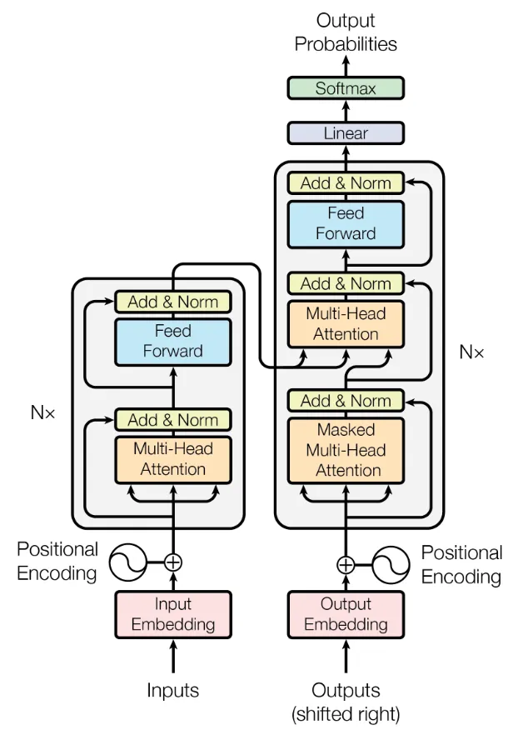
Transformer Architecture
Transformers process sequences of tokens such as (sub-)words in a sentence.
The transformer architecture consists of two parts:
The encoder, which processes the tokens of the input sequence and
The decoder, which produces new tokens as output based on the input tokens and the previously produced output tokens.
The overall architecture is shown in the figure with the encoder on the left and the decoder on the right side.
Encoder Decoder
Q K V
Q K V
https://builtin.com/artificial-intelligence/transformer-neural-network

Slide 40
LLM – Large Language Model

Slide 41
What is LLM?
A large language model (LLM) is a language model notable for its ability to achieve general-purpose language generation and other natural language processing tasks such as classification.
LLMs acquire these abilities by learning statistical relationships from text documents during a computationally intensive self-supervised and semi-supervised training process.
LLMs can be used for text generation, a form of generative AI, by taking an input text and repeatedly predicting the next token or word.

Slide 42
LLMs are artificial neural networks.
ChatGPT is a LLM.
The largest and most capable, as of March 2024, are built with a decoder-only transformer-based architecture while some recent implementations are based on other architectures, such as recurrent neural network variants.

Slide 43
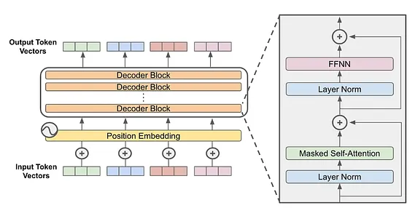
The Decoder-Only Transformer Architecture
The decoder-only transformer architecture is comprised of several “blocks” with identical structure that are stacked in sequence.
https://cameronrwolfe.substack.com/p/decoder-only-transformers-the-workhorse

Slide 44
Generative AI

Slide 45
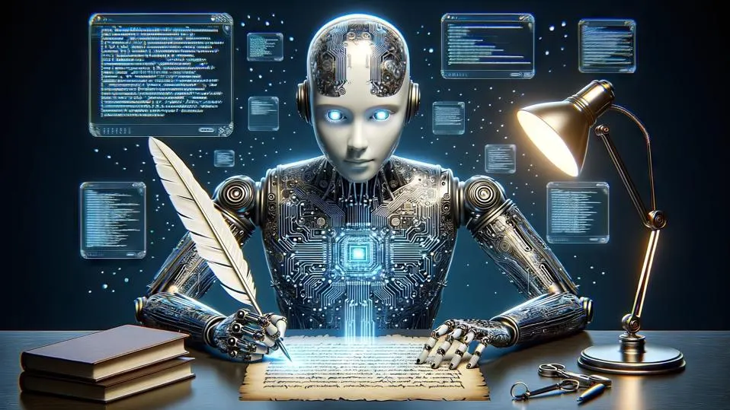
What is Generative AI?
Generative AI is a type of artificial intelligence technology that can produce various types of content, including text, imagery, audio and synthetic data.
Generative models achieve this by analyzing massive datasets to identify underlying patterns and relationships within the data.
Subsequently, they leverage this knowledge to generate novel content that closely resembles the data they were trained on.

Slide 46
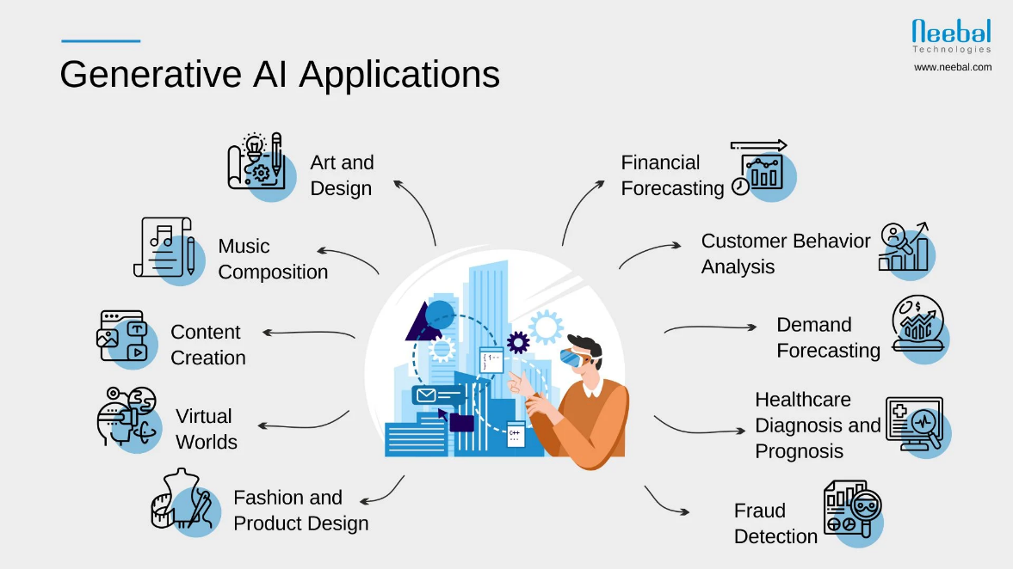
Core Functionalities of Generative AI:
Text Generation: From crafting realistic dialogue for chatbots to composing creative fiction, generative AI can produce human-quality text content.
Image Creation: Generative models can create new images that mimic existing artistic styles or generate entirely novel photorealistic pictures.
Code Generation: AI can automate code writing by generating functional code snippets based on specific requirements.
Music Composition: AI has the potential to compose original music pieces in various styles, fostering creativity in the music industry.

Slide 47
GPT – Generative Pre-Trained Transformers

Slide 48
GPT - What is This?
Generative pre-trained transformers (GPT) are a type of large language model (LLM) and a prominent framework for generative artificial intelligence.
They are artificial neural networks that are used in natural language processing tasks.
GPTs are based on the transformer architecture, pre-trained on large data sets of unlabelled text, and able to generate novel human-like content.
As of 2024, most LLMs have these characteristics and are sometimes referred to broadly as GPTs.

Slide 49
ChatGPT
The first GPT was introduced in 2018 by OpenAI.
OpenAI has released very influential GPT foundation models that have been sequentially numbered, to comprise its "GPT-n" series.
Each of these was significantly more capable than the previous, due to increased size (number of trainable parameters) and training.
The most recent of these, GPT-4, was released in March 2023.
Such models have been the basis for their more task-specific GPT systems, including models fine-tuned for instruction following—which in turn power the ChatGPT chatbot service.[

Slide 50
Gemini

Slide 51
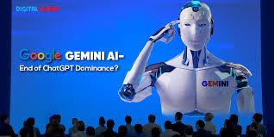
Google Gemini
Gemini is a Generative AI application developed by Google DeepMind and introduced on December 6, 2023.
In the Gemini app,
tap Camera, take a photo, and ask questions about it.
get help with writing, correcting grammar, and translating.
get inspiration for activities to do and visualize your plans on a map.
generate images on the fly.
Summarize or get an overview of a topic in any format you want, like a list, table, or chart.

Slide 52
Diffusion Model

Slide 53
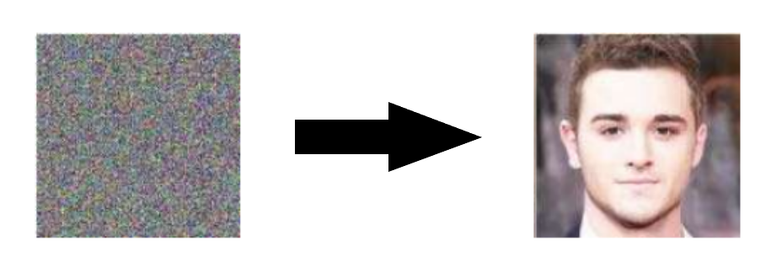
Diffusion Models - Introduction
Diffusion Models are generative models, meaning that they are used to generate data similar to the data on which they are trained.
Fundamentally, Diffusion Models work by destroying training data through the successive addition of Gaussian noise, and then learning to recover the data by reversing this noising process.
After training, we can use the Diffusion Model to generate data by simply passing randomly sampled noise through the learned denoising process.
https://www.assemblyai.com/blog/diffusion-models-for-machine-learning-introduction/

Slide 54
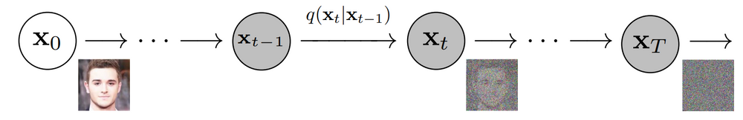
Diffusion Process as Markov Chain
More specifically, a Diffusion Model is a latent variable model which maps to the latent space using a fixed Markov chain.
This chain gradually adds noise to the data in order to obtain the approximate posterior q(x_{1:T}|x₀), where x₁,…,x_{T} are the latent variables with the same dimensionality as .
In the figure below, we see such a Markov chain manifested for image data.

Slide 55
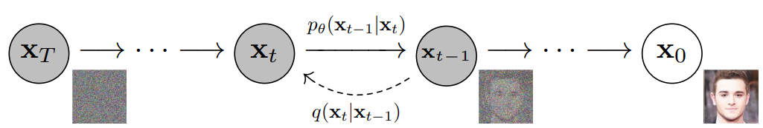
Diffusion Process as Markov Chain
Ultimately, the image is asymptotically transformed to pure Gaussian noise.
The goal of training a diffusion model is to learn the reverse process - i.e. training p_{θ}(x _{t-1} |x_{t}).
By traversing backwards along this chain, we can generate new data.

Slide 56
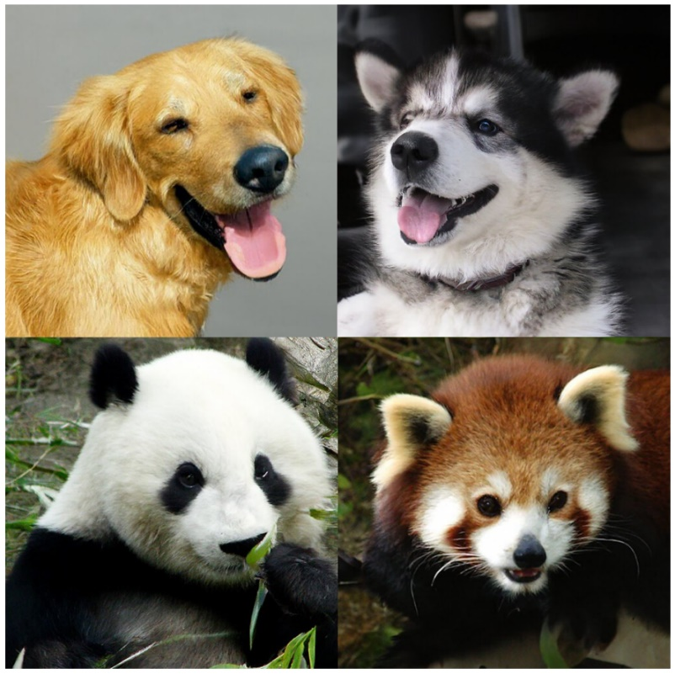
Benefits of Diffusion Models
As mentioned above, research into Diffusion Models has exploded in recent years.
Inspired by non-equilibrium thermodynamics, Diffusion Models currently produce State-of-the-Art image quality, examples of which can be seen below:

Slide 57
No Need for Heavy Training
Beyond cutting-edge image quality, Diffusion Models come with a host of other benefits, including not requiring adversarial training.
The difficulties of adversarial training are well-documented; and, in cases where non-adversarial alternatives exist with comparable performance and training efficiency, it is usually best to utilize them.
On the topic of training efficiency, Diffusion Models also have the added benefits of scalability and parallelizability.

Slide 58
How does It Produce Results?
While Diffusion Models almost seem to be producing results out of thin air, there are a lot of careful and interesting mathematical choices and details that provide the foundation for these results, and best practices are still evolving in the literature.
Let's take a look at the mathematical theory underpinning Diffusion Models in more detail now.

Slide 59
Understanding Diffusion Models
As mentioned above, a Diffusion Model consists of a forward process (or diffusion process), in which a datum (generally an image) is progressively noised, and a reverse process (or reverse diffusion process), in which noise is transformed back into a sample from the target distribution.
The sampling chain transitions in the forward process can be set to conditional Gaussians when the noise level is sufficiently low.
Combining this fact with the Markov assumption leads to a simple parameterization of the forward process:

Slide 60
Understanding Diffusion Models
Combining this fact with the Markov assumption leads to a simple parameterization of the forward process:
where β₁,…,β_{T} is a variance schedule (either learned or fixed) which, if well-behaved, ensures that is nearly an isotropic Gaussian for sufficiently large T.

Slide 61
”Magic” of Diffusion Model
As mentioned previously, the "magic" of diffusion models comes in the reverse process. During training, the model learns to reverse this diffusion process in order to generate new data. Starting with the pure Gaussian noise p(x_{T}) = N(x_{T},0,I) , the model learns the joint distribution p_{θ}(x_{0:T}) as
where the time-dependent parameters of the Gaussian transitions are learned.

Slide 62
”Magic” of Diffusion Model
Note in particular that the Markov formulation asserts that a given reverse diffusion transition distribution depends only on the previous timestep (or following timestep, depending on how you look at it):

Slide 63
Training of Diffusion Model
A Diffusion Model is trained by finding the reverse Markov transitions that maximize the likelihood of the training data.
In practice, training equivalently consists of minimizing the variational upper bound on the negative log likelihood.

Slide 64
Chapter 22 – Attention Model, Transformers, GPT

